Slide 1
Guided Imagery – Safe Calm Space
Peace Out Guided Relaxation for Kids – Balloon by Cosmic Kids
https://youtu.be/ZBnPlqQFPKs

Slide 2
NEED SUPPLIES:
Paper, crayons, markers, or colored pencils.
Where did your balloon take you. Draw a picture of your safe, peaceful, calm space.

Slide 3
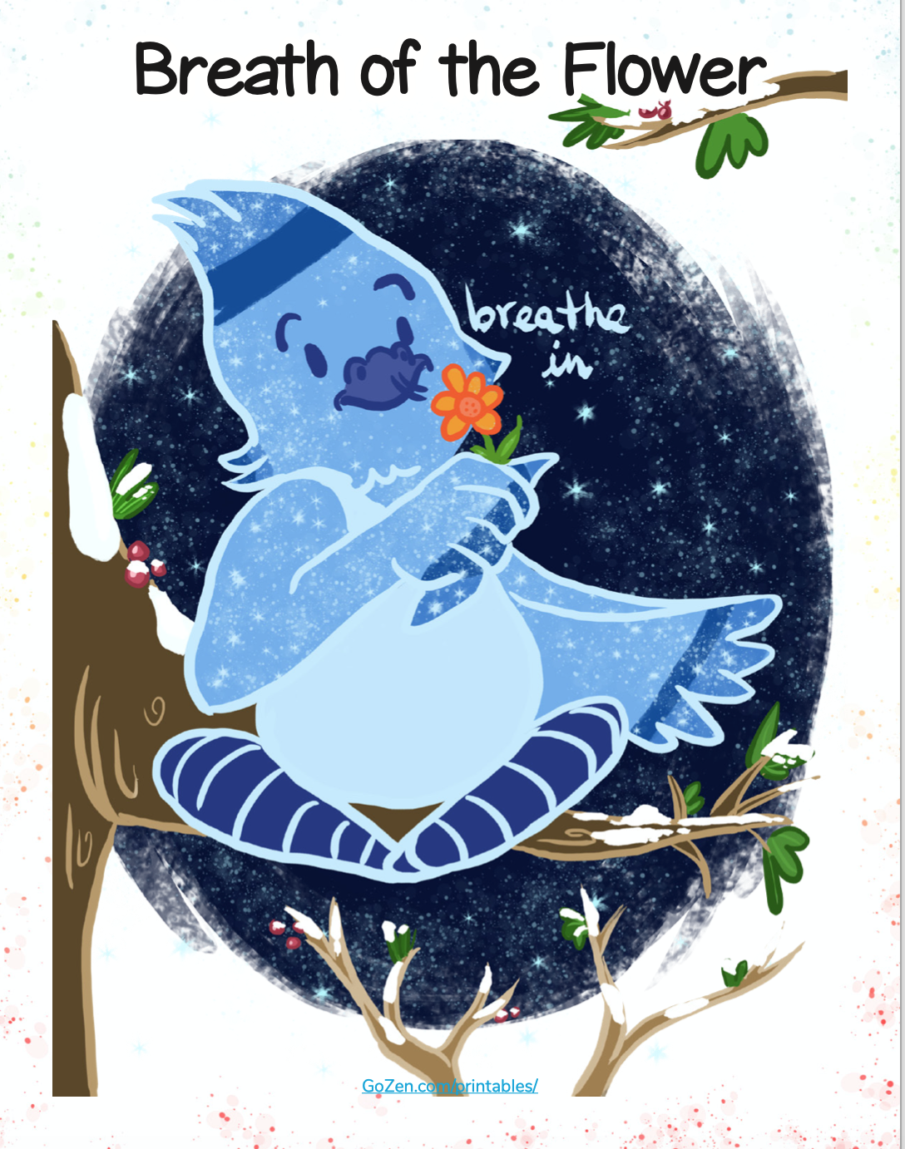
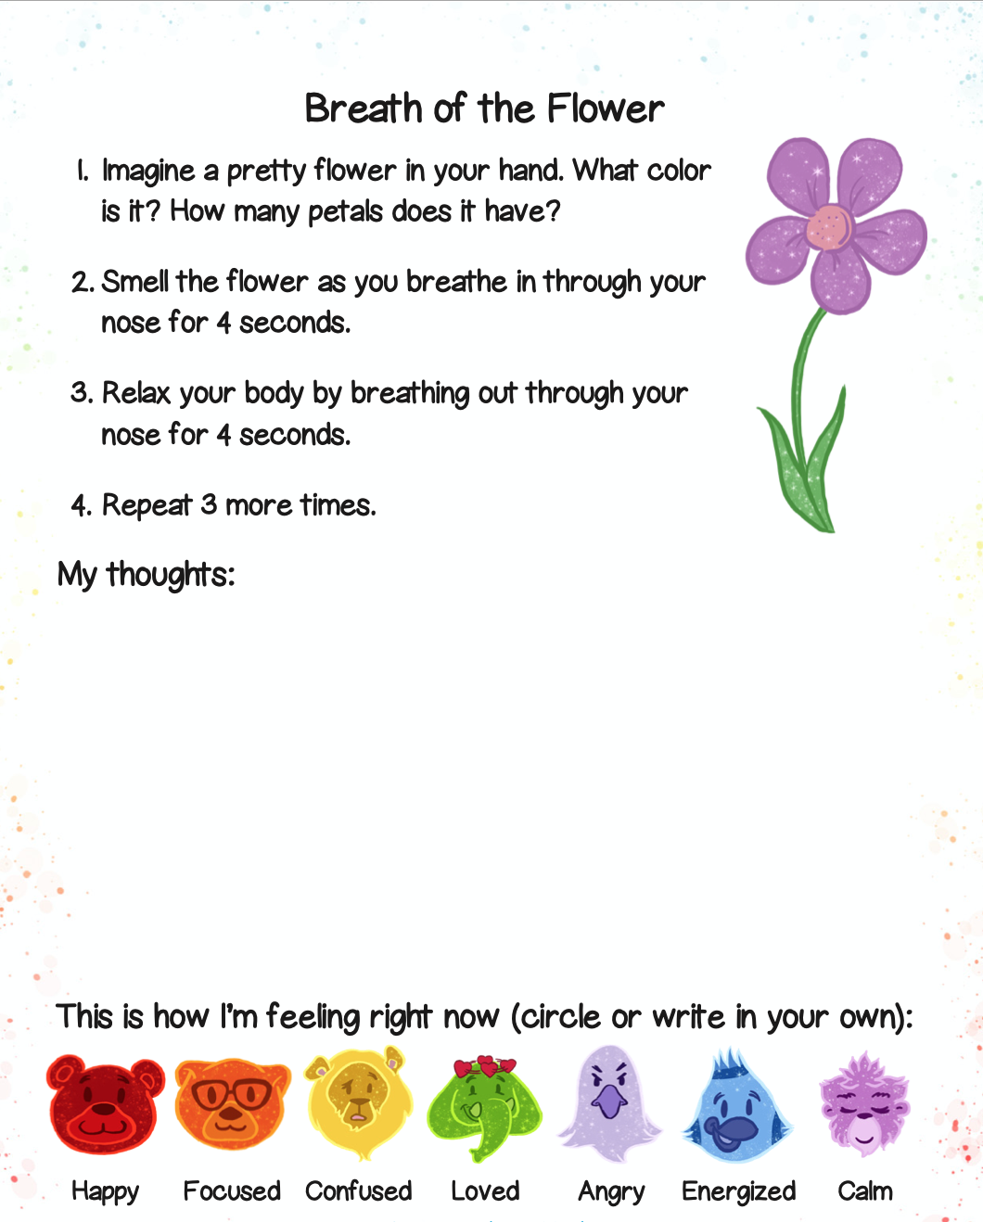
Breath of the Flower

Slide 4
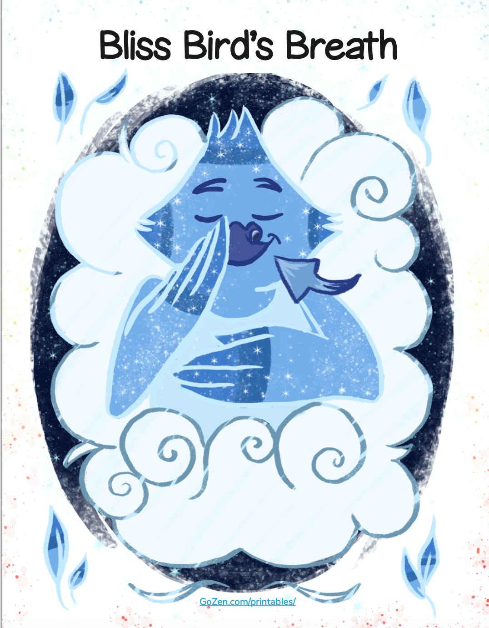
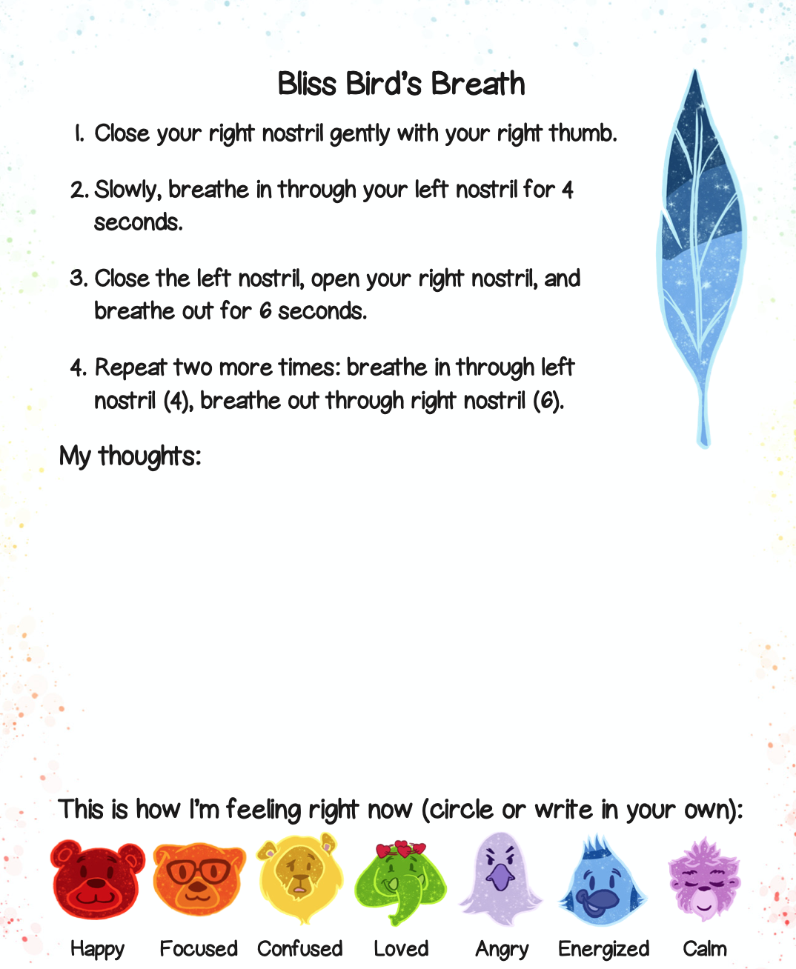
Bliss Bird’s Breath

Slide 5
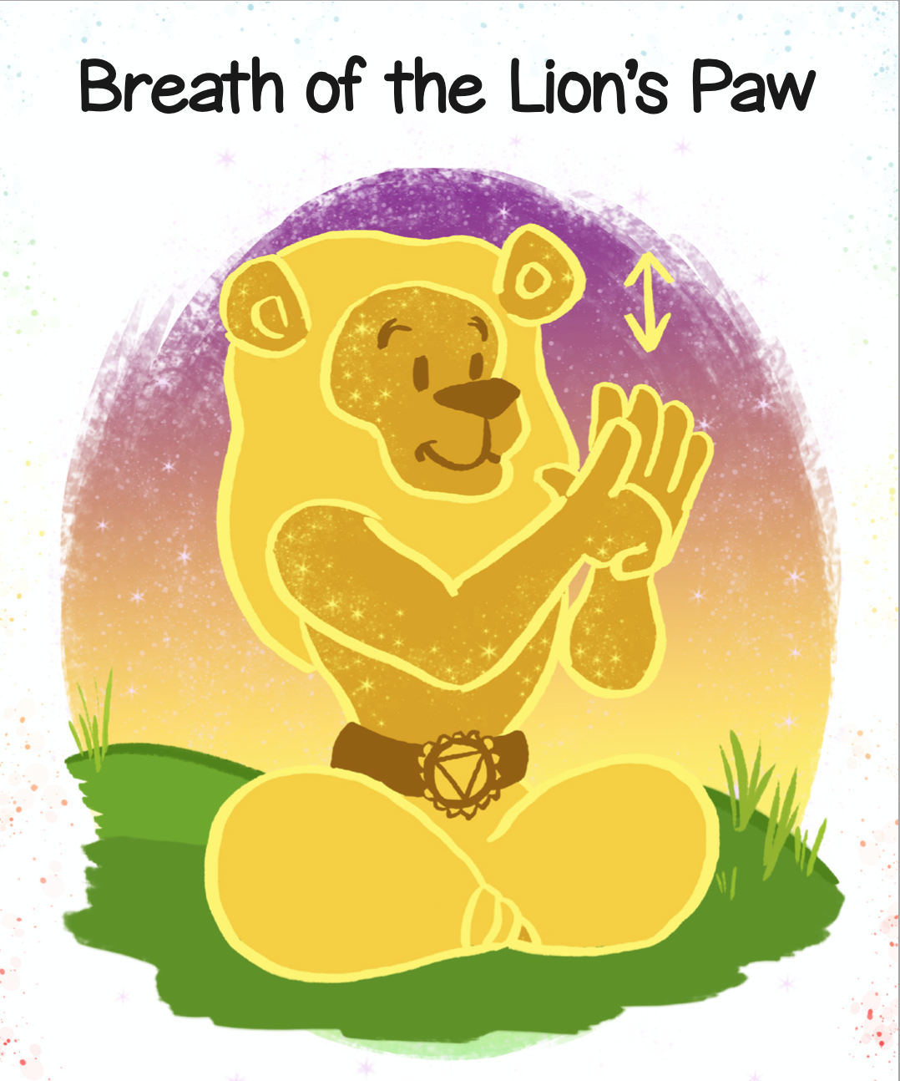
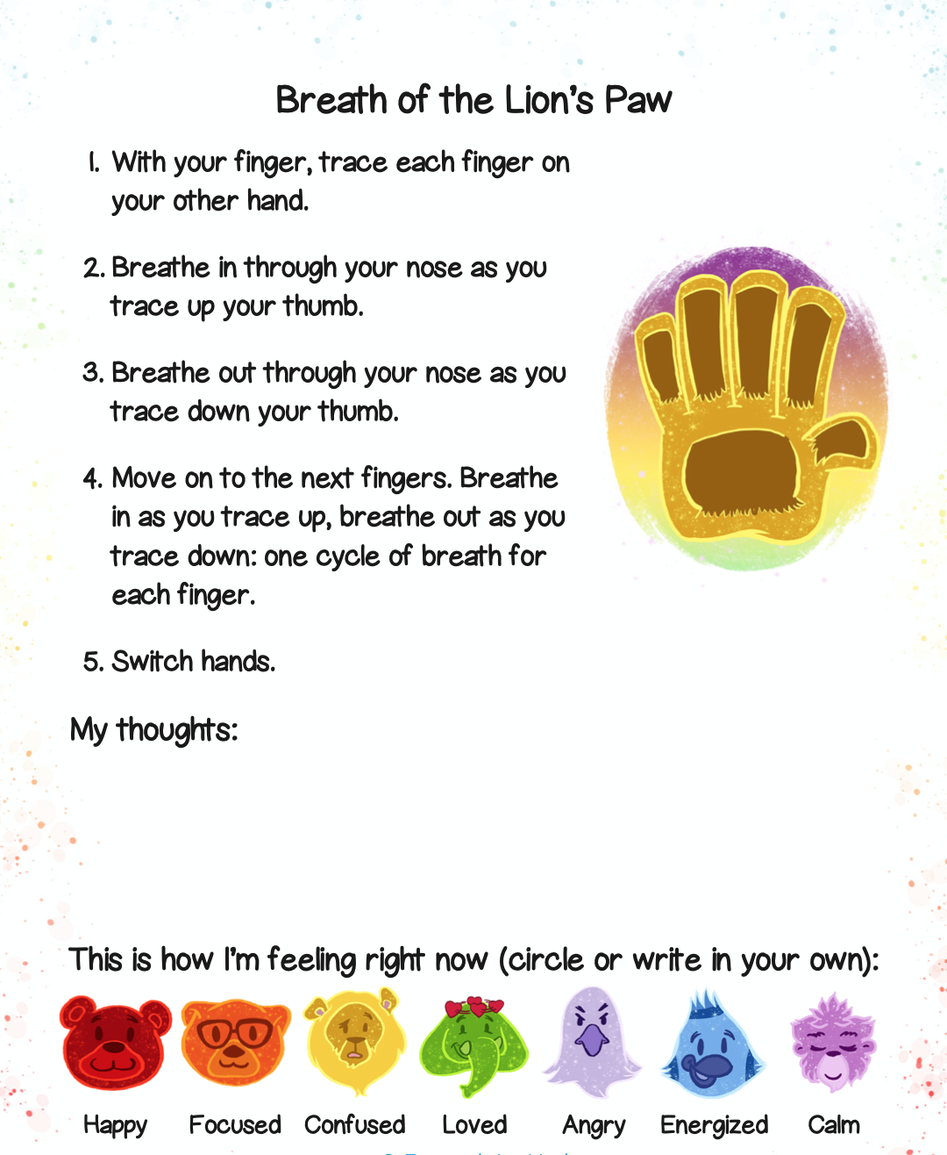
Breath of the Lion’s Paw

Slide 6
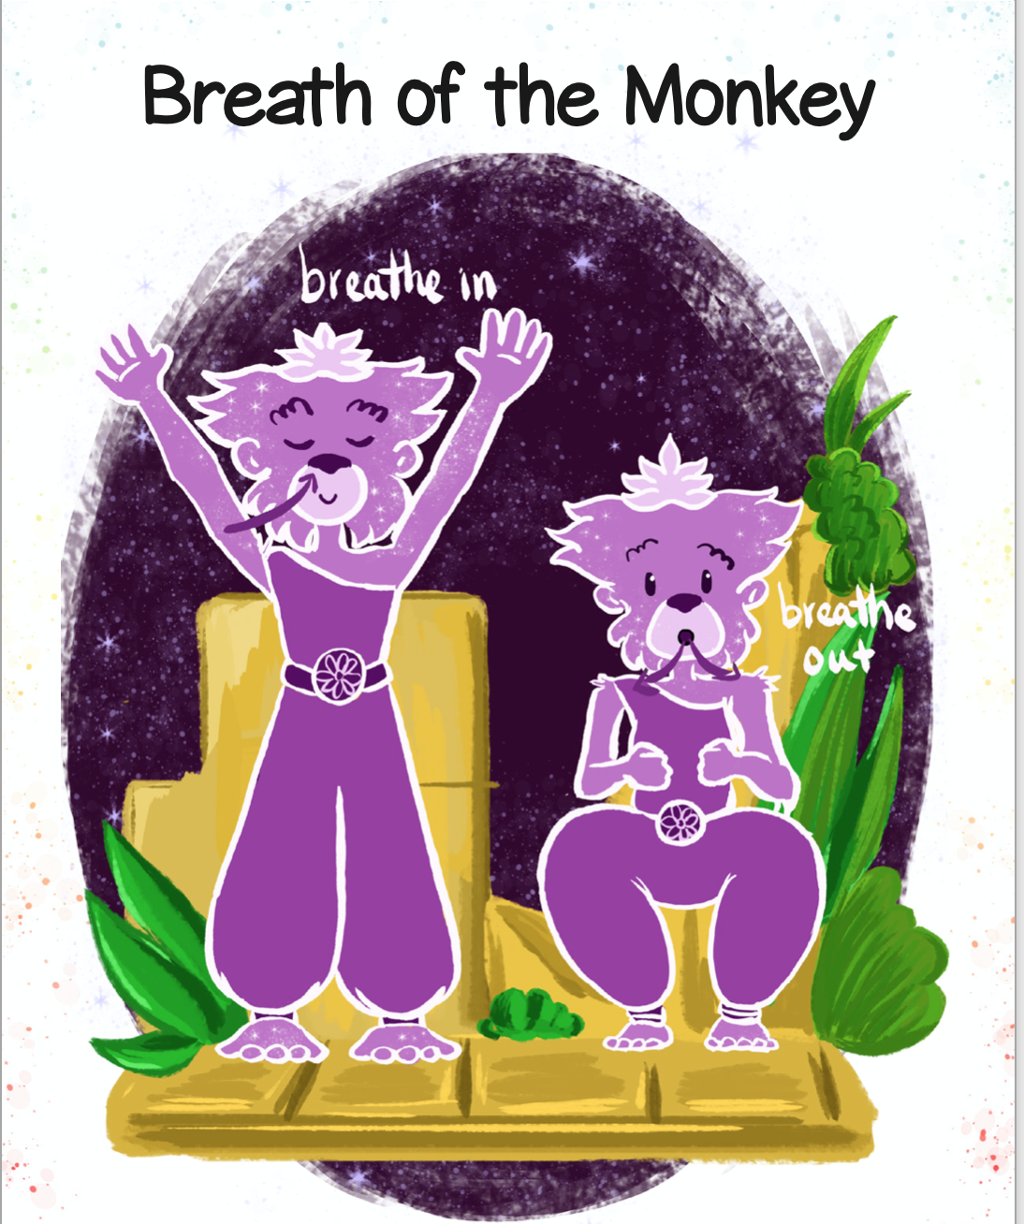
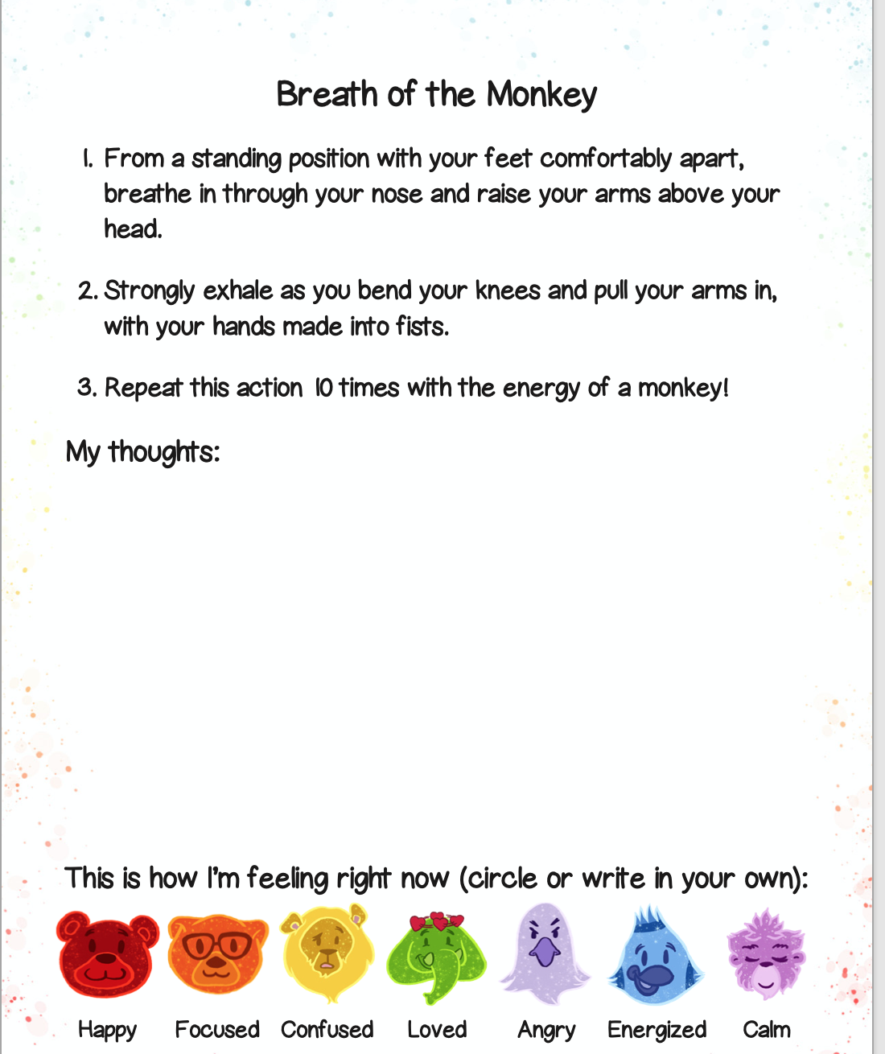
Breath of the Monkey

Slide 7
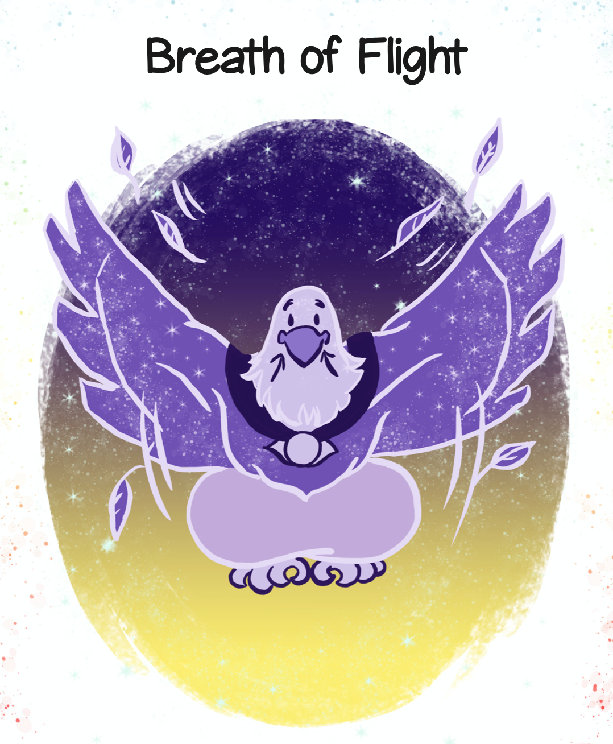
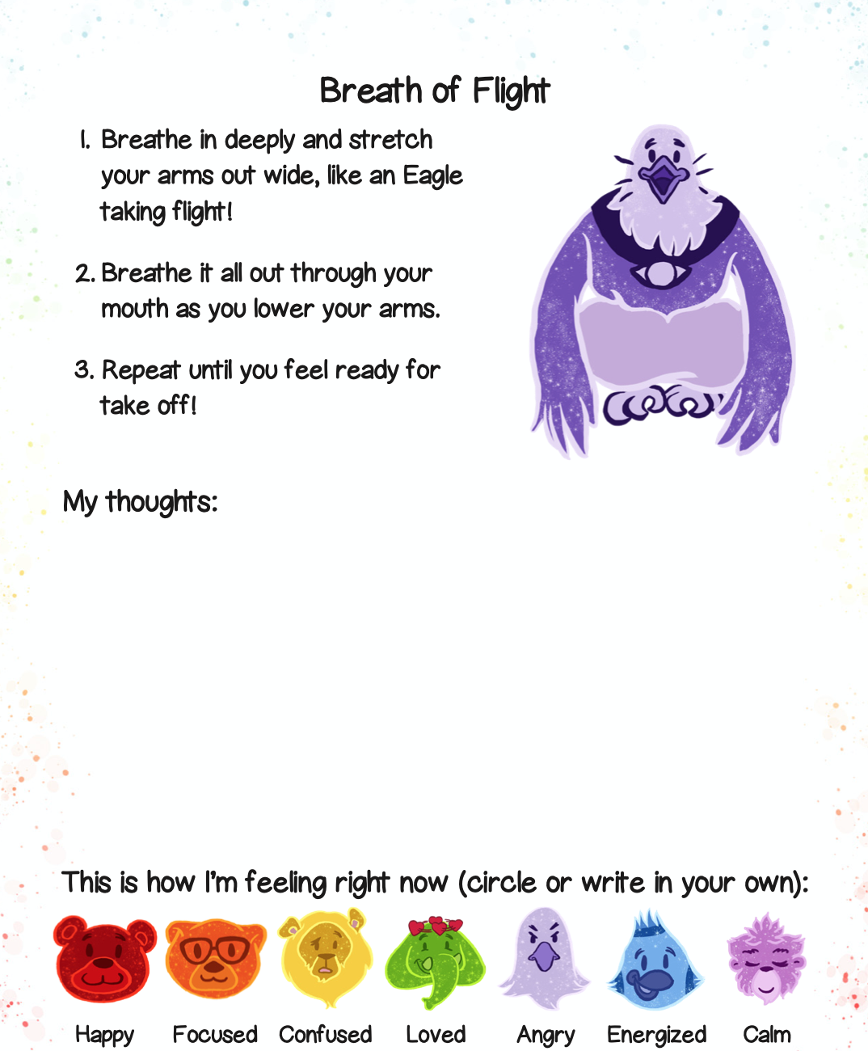
Breath of Flight

Slide 8
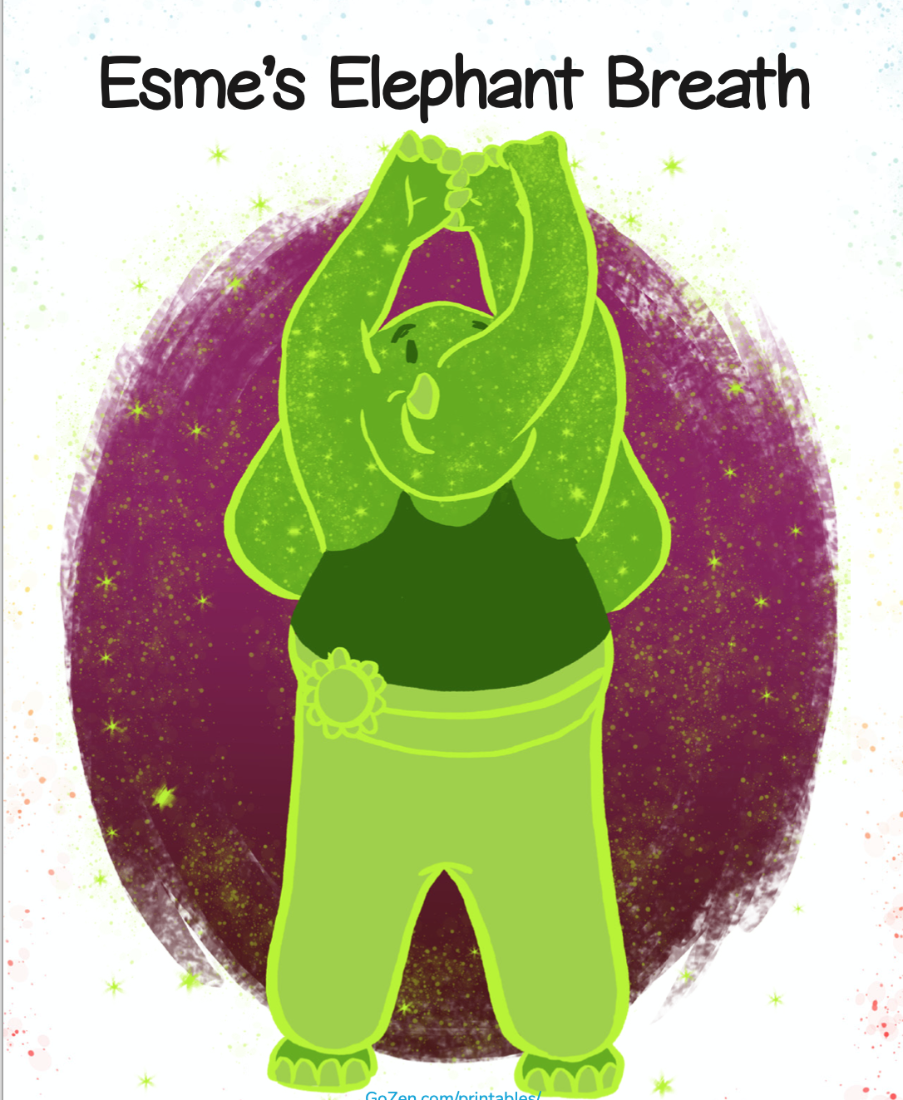
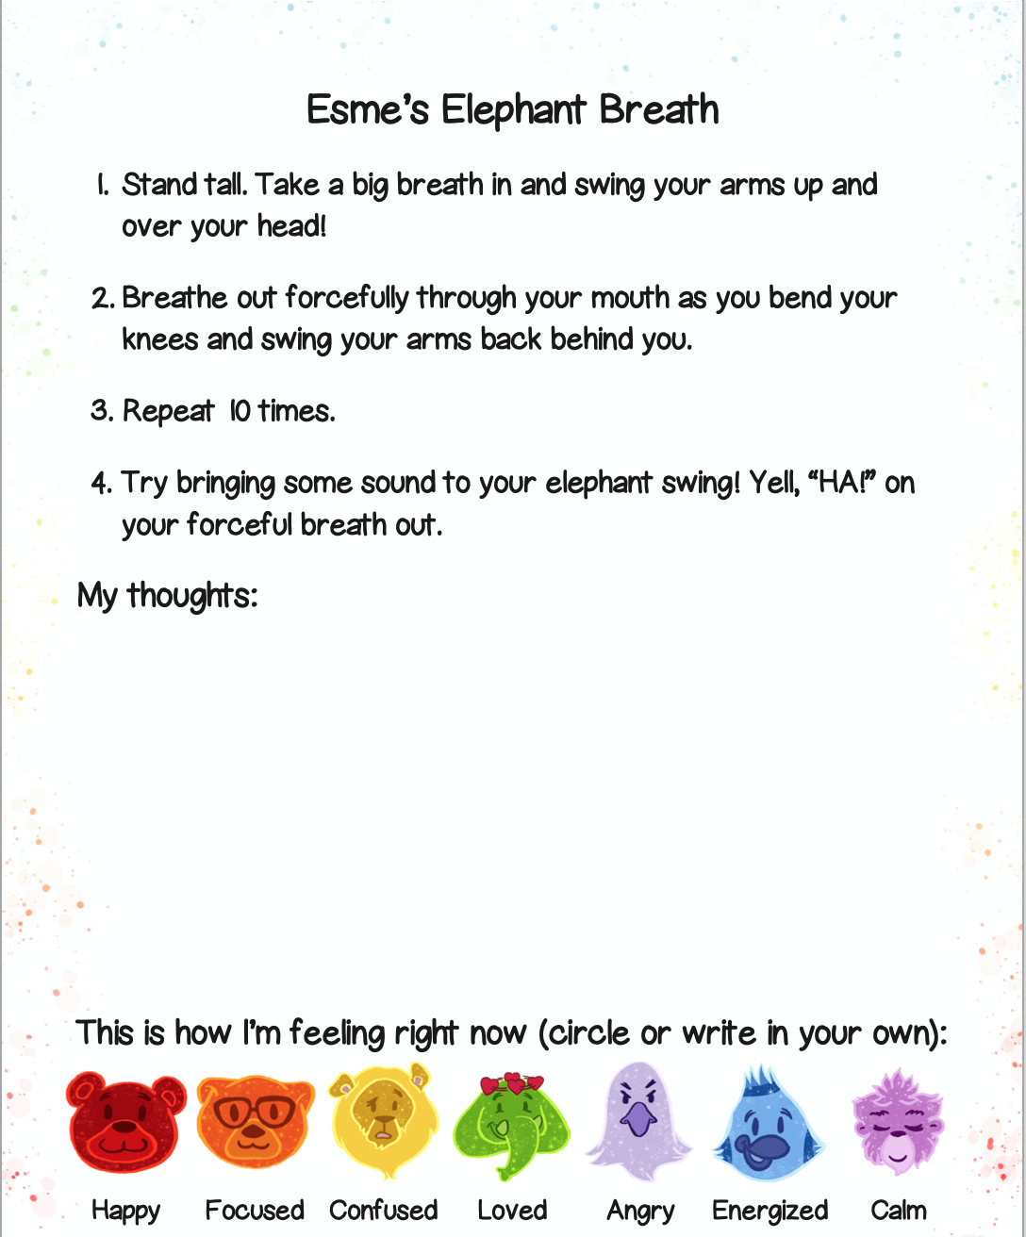
Esme’s Elephant Breath

Slide 9
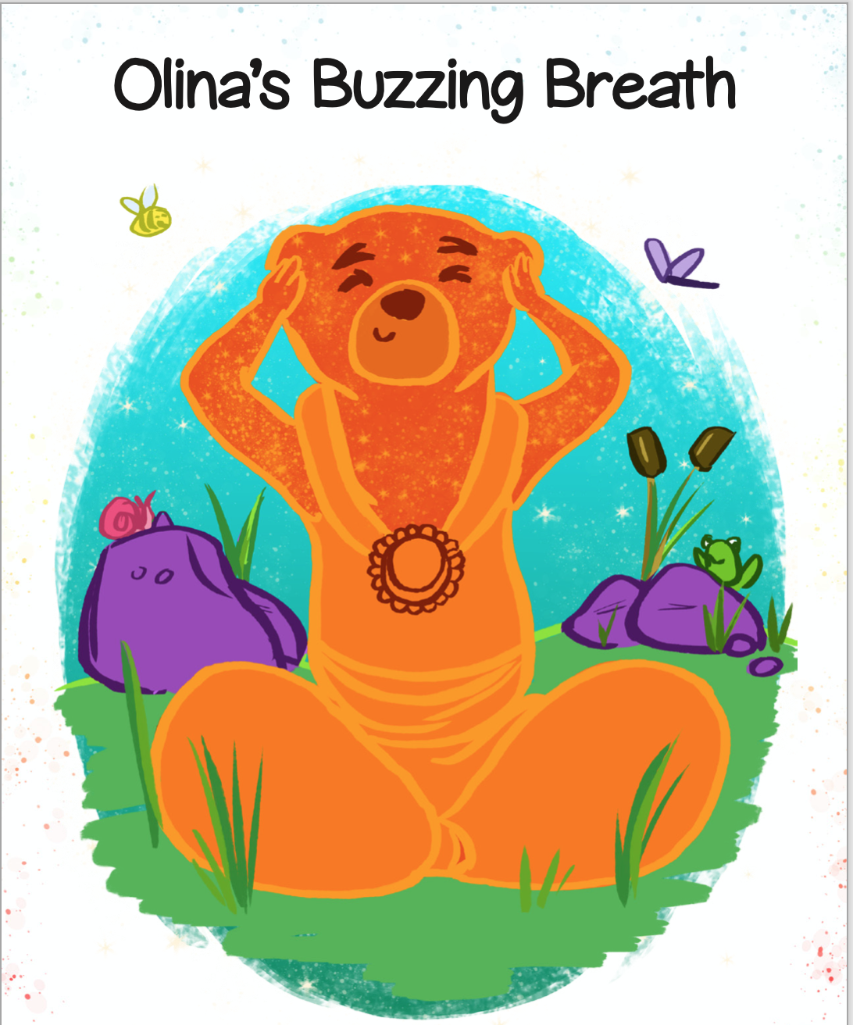
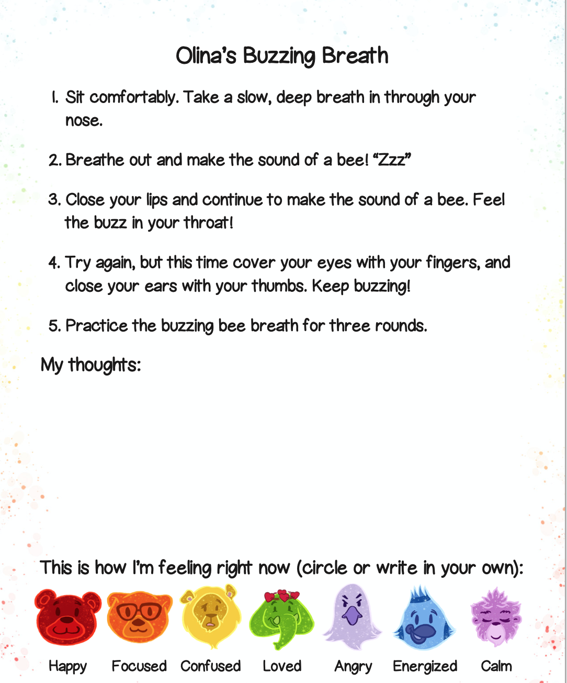
Olina’s Buzzing Breath

